Slide 1


4
Music Recommendation Application
Based on Facial Expressions
Review
Under the guidance of Ms MD ARSHA SULTHANA
Batch 9
17HP1A0583
17HP1A0561
17HP1A0571

Slide 2
Introduction
Music is the form of art, which is known to have a greater connection with a person’s emotion.
It has got a unique ability to lift up one’s mood.
Our project focuses on building an efficient music recommendation system
which determines the emotion of user using Facial Recognition techniques.
It has widely attracted attention due to its enormous application value and market potential.
Face recognition Technology is being implemented in various fields like security system,
digital video processing, and many such technological advances.
Moreover, on a larger dimension, this would render savage of time and labor invested
in performing the process manually. We use Viola Jones algorithm for face recognition
and Fisher Faces classifier for identifying facial expressions.
The overall concept of the system is to recognize facial emotion, mood and recommend
songs efficiently. The proposed system will be both time and cost efficient.

Slide 3
Problem Statement
Our primary goal is to recommend music
by detecting the mood of a person.
As music holds the power to cheer up a person’s mood
Our project aims to recommend the best playlist which
matches the mood of a person and ends with cheerful music.

Slide 4
Project Objectives
Everyone battle with emotions due to different reasons.
Ultimately everyone want to be happy.
Creating an application which can make a person
happier by detecting the mood of a person
using facial recognition techniques.

Slide 5
Scope
People with Internet access and have interest in Music
irrespective of age group, gender,ethnicity and occasion.

Slide 6
Literature Survey
Music Recommender system for users based on
Emotion Detection through Facial Features
By
A Alrihaili, A Alsaedi, K Albalawi, L Syed
This proposed system detects the emotions and recommends playlists.
If the subject has a negative emotion then the recommended playlist will improve one’s mood. If the detected emotion is positive then a playlist
with different types of music will be included which can enhance the positive emotions of a person.

Slide 7
Literature Survey
Application of machine learning in Recommendation Systems
By
Nawrocka A, Kot A, Nawrocki M
There are many algorithms and classification techniques for every problem in Machine Learning. Choosing a right method is essential to create a customized solution for different problems. In this paper, the advantages, disadvantages, similarities, measures for evaluating the algorithm, sample value of evaluation prediction are discussed.

Slide 8
Literature Survey
Emotion based mood enhancing
Music Recommendation
By
Iyer A V, Prasad V, Sankhe S R, Prajapati K
This paper proposes an ‘EmoPlayer’, an Android Application, which helps to minimize the efforts by suggesting the user a list of songs based on his current emotion. The system uses user’s image using camera, detects his face and emotions to recommend a playlist which can enhance the user.

Slide 9
Literature Survey
Face Recognition using Machine Learning
By
Arun A, Peter Neal B
This paper proposed a Facial Recognition system using Machine Learning specifically Support Vector Machines. A face is initially detected by using Viola Jones algorithm. Then feature extraction on face is performed using Histogram of Oriented Gradients which essentially stores the edge of the face as well as the directionality of the edges. Training and classification of the facial databases is done using the multi class SVM where each unique face in the Facial database is a class.

Slide 10
Methodology
Viola Jones Algorithm is an object detection framework
proposed in 2001 by Paul Viola and Michael Jones.
This algorithm is primarily used for Face Detection.
Detection
Training
Output

Slide 11
Methodology
Fisher face classifier is one of the most widely
used face mood detection technique
because of it’s effort to maximize the separation
between classes in the training process.
This classifier is based on Linear Discriminant Analysis,
a supervised technique.
Recognizer will be trained with numerous samples.

Slide 12
Methodology
Content based recommendation will be used for recommending Music playlist based on the mood detected.
By using pre-defined clusters based on genres which are available on Koggle, the playlist can be fetched by using nearest neighbour.

Slide 13
Methodology
HTML will be used for creating web page with a user friendly interface.
PHP will be used for connecting database.
CSS will be used for styling the web page.

Slide 14
System Architecture
VIEW
Browser
Controller
Login/
Signup
Home Page
Playlist
Recommender
Authentication
Image Capture
Algorithm
Model
SQL Database

Slide 15
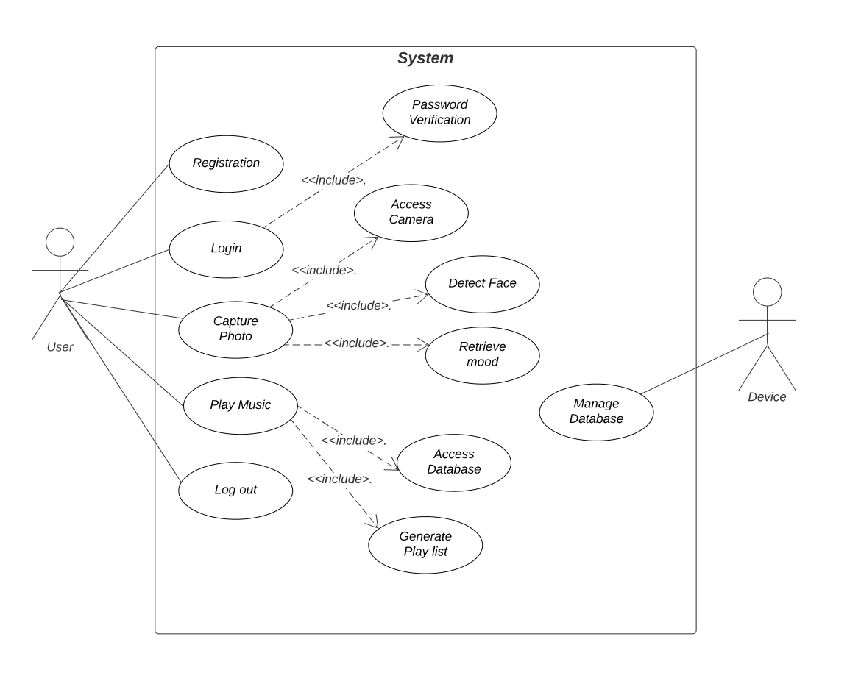
Use case Diagram

Slide 16
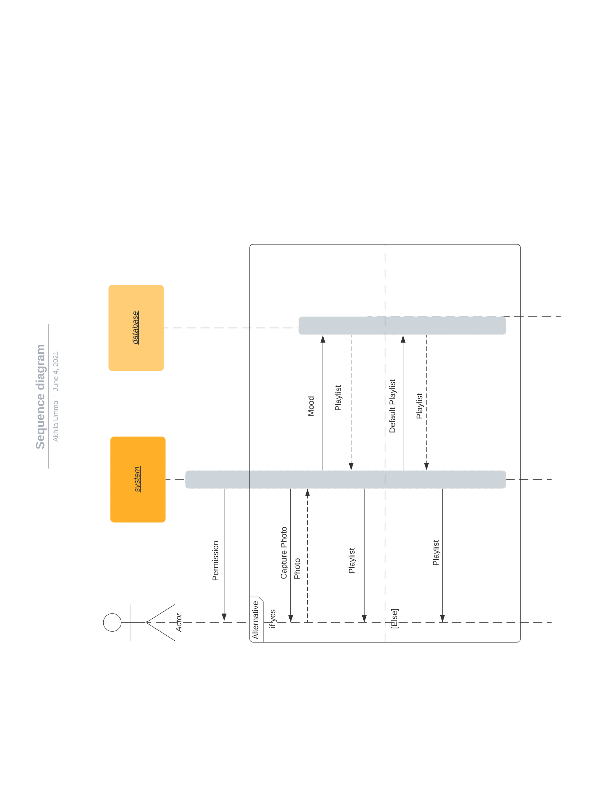
Sequence Diagram

Slide 17
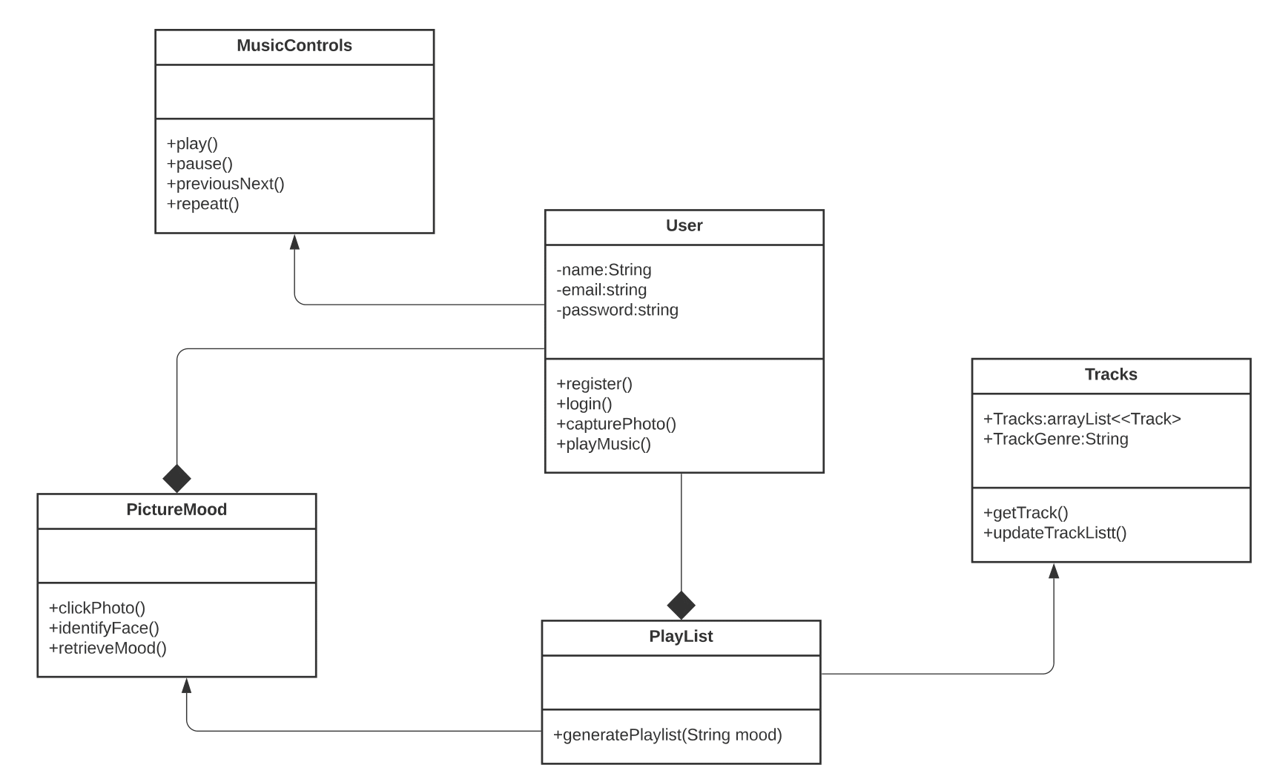
Class Diagram

Slide 18
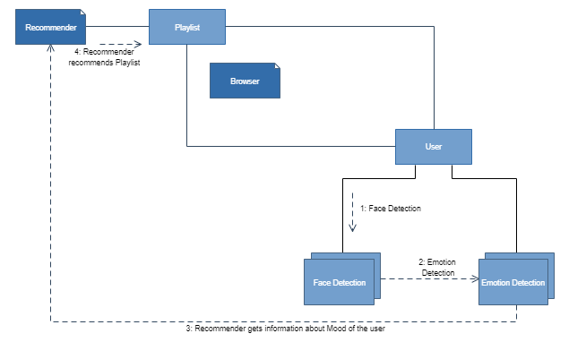
Collaboration Diagram

Slide 19
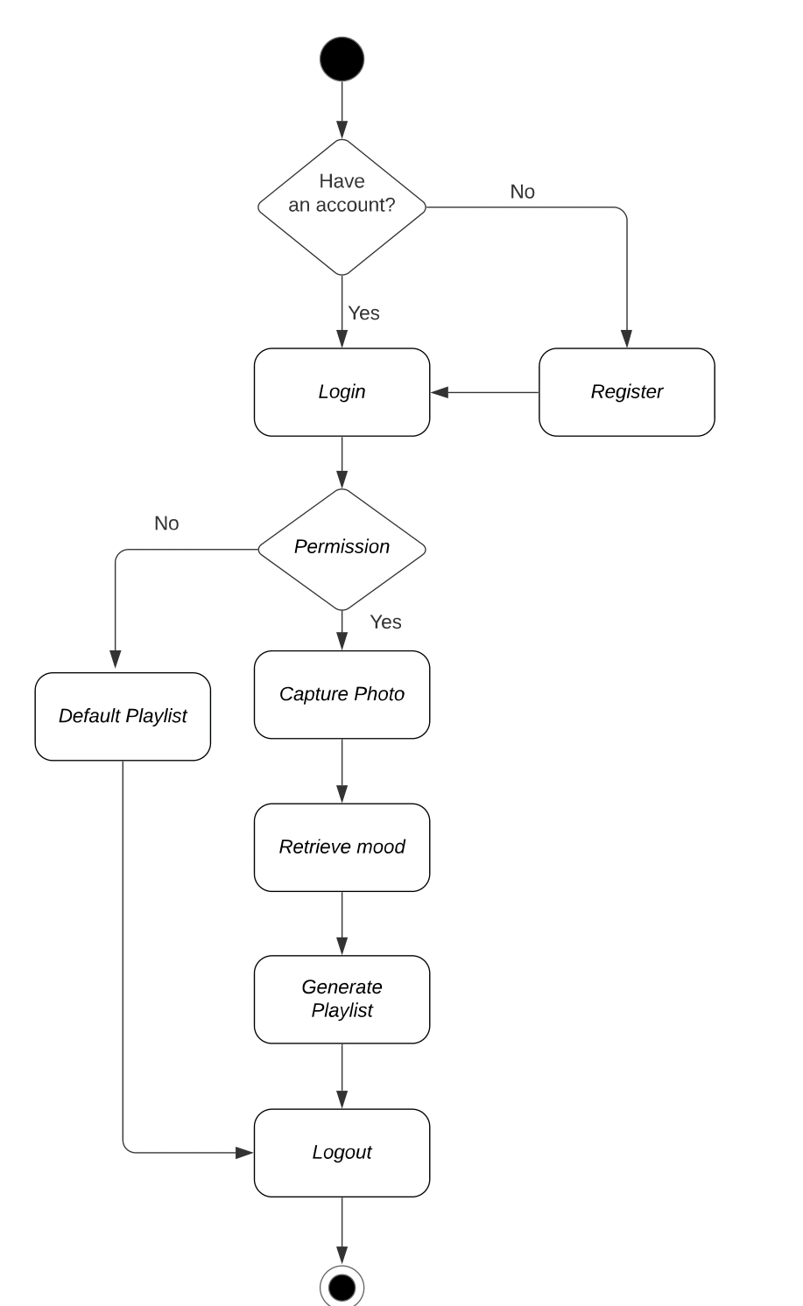
Activity Diagram

Slide 20
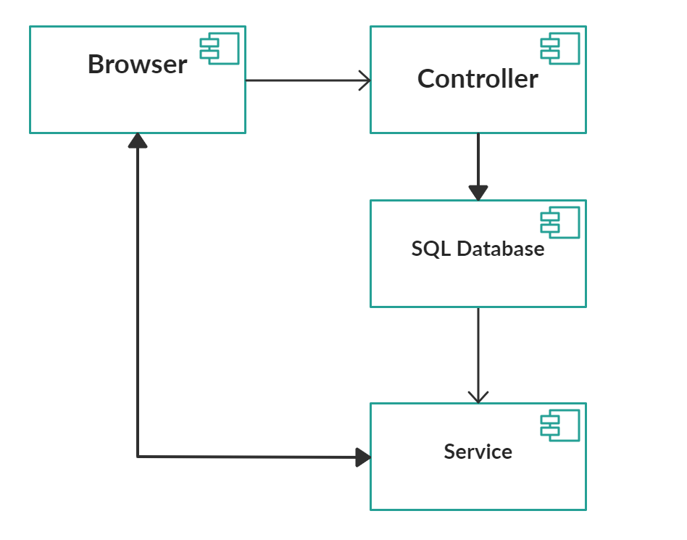
Component Diagram

Slide 21
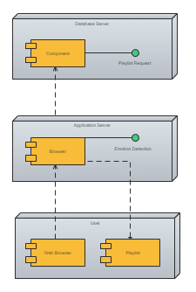
Deployment Diagram

Slide 22
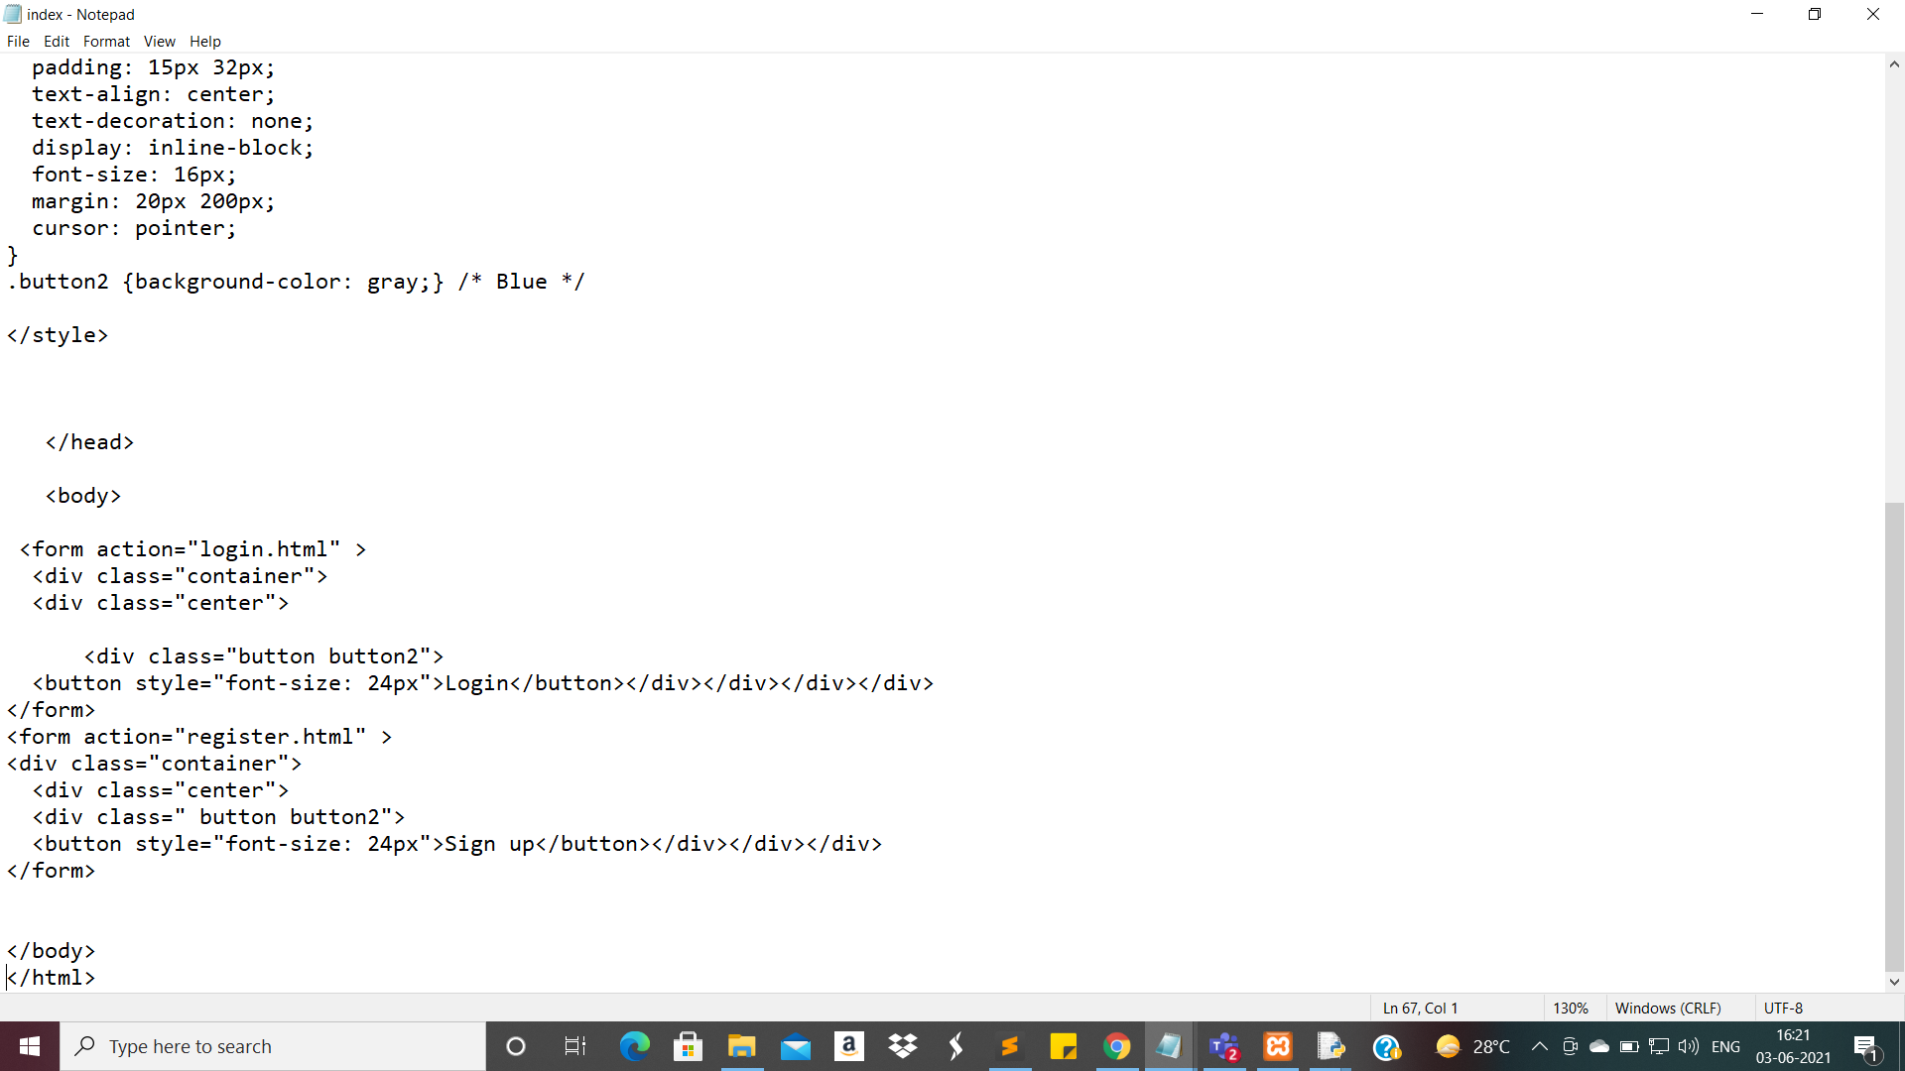
Index Page

Slide 23
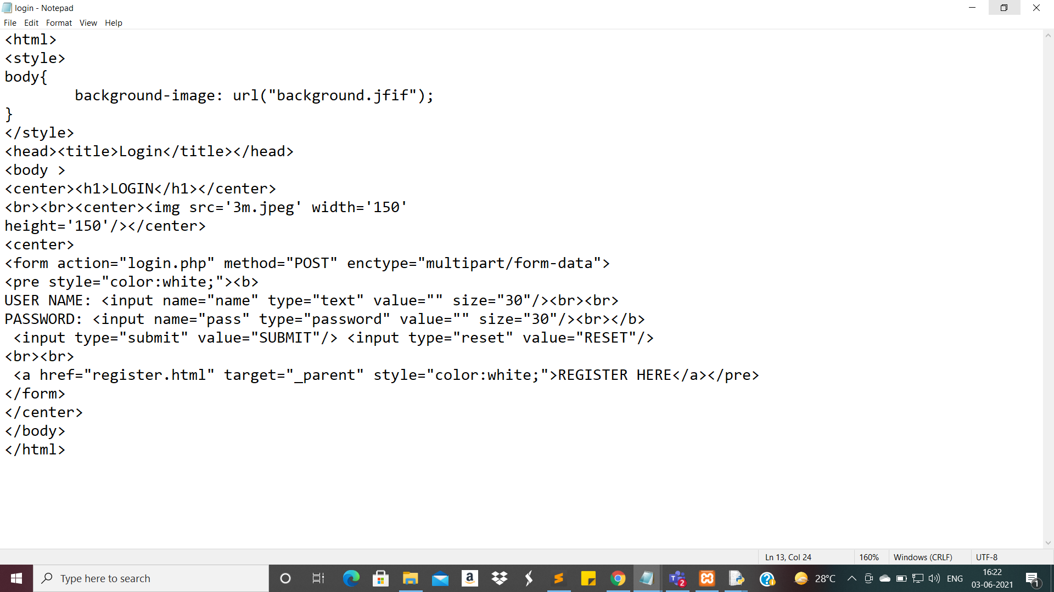
Login page

Slide 24
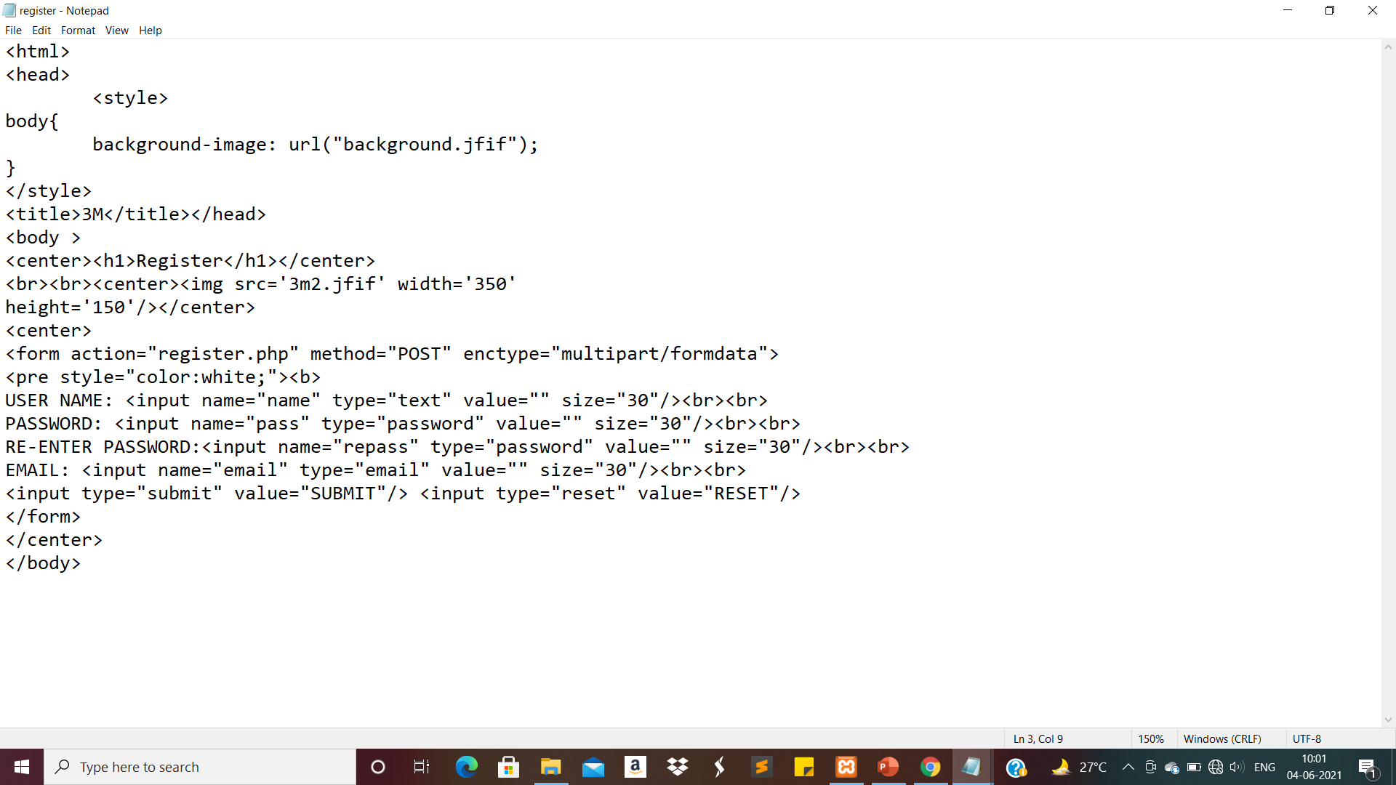
Signup Page

Slide 25
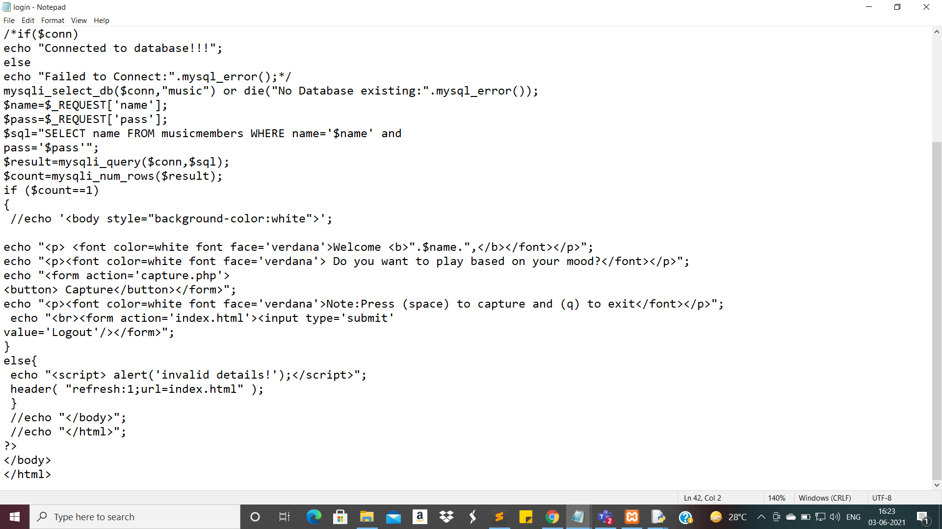
After Login

Slide 26
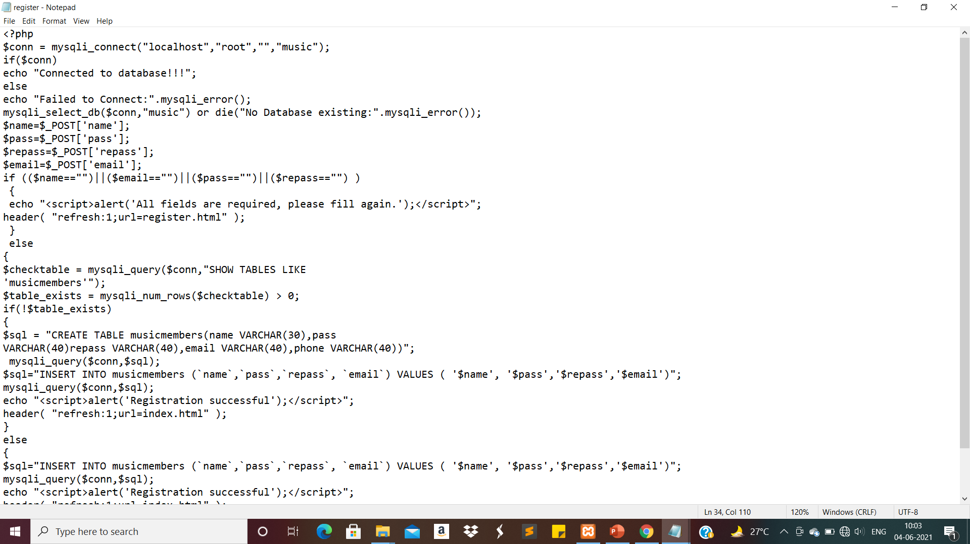
To add new user

Slide 27
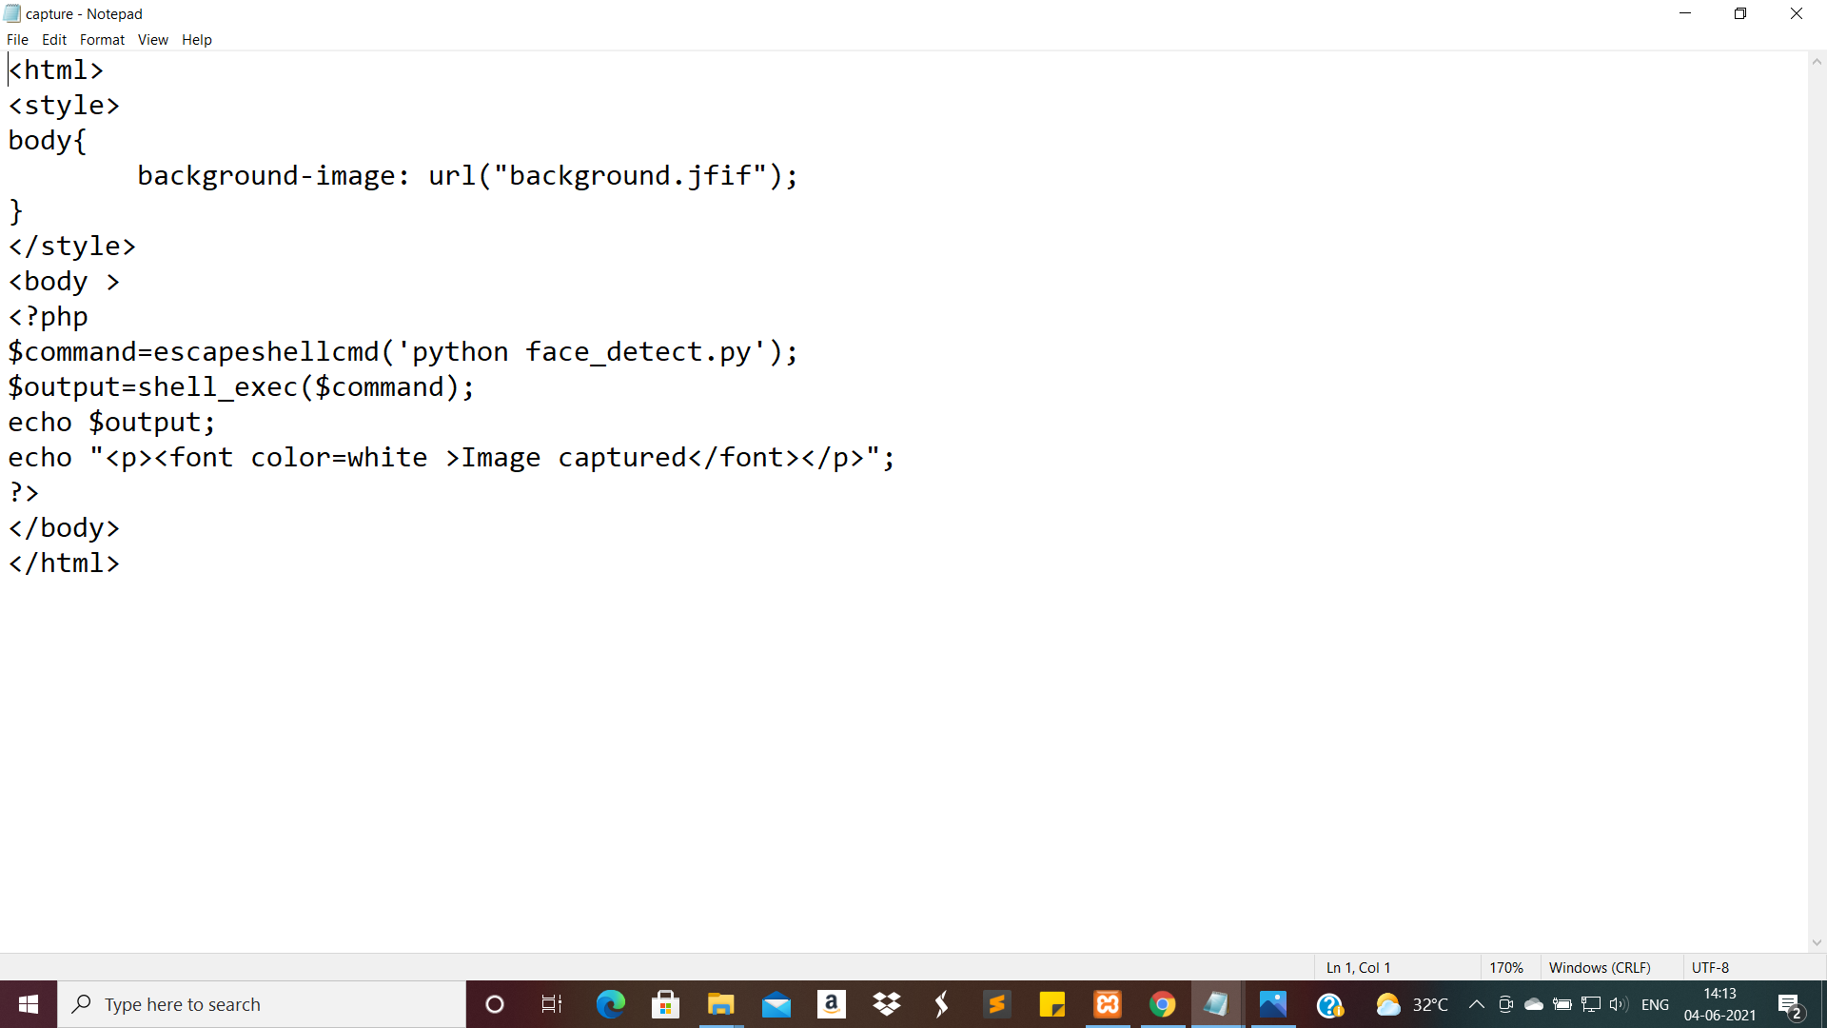
Call Face detect file

Slide 28
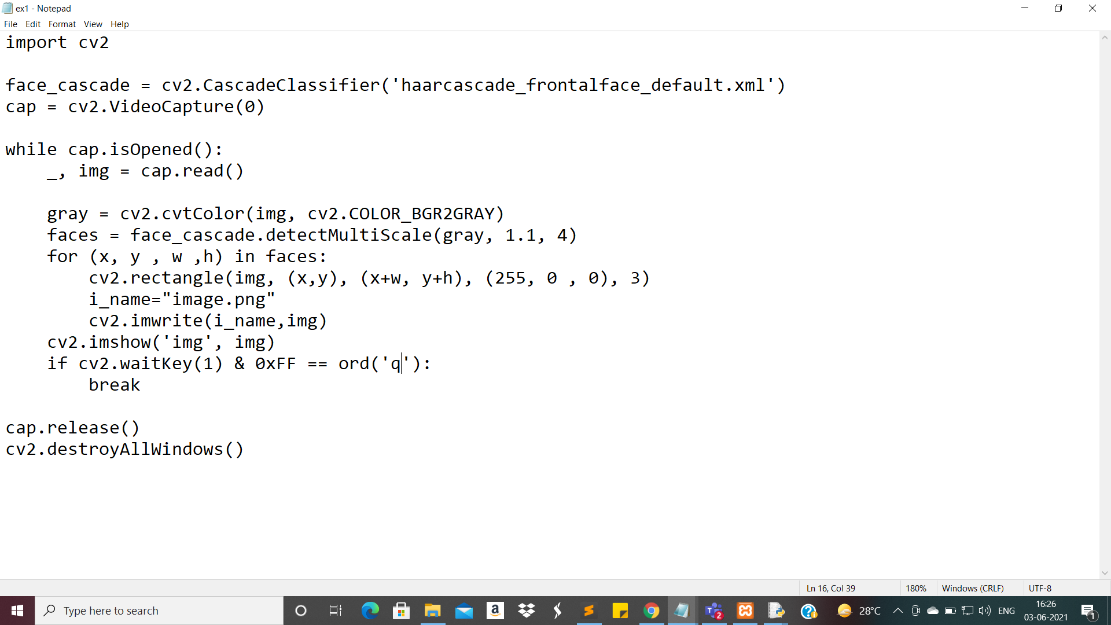
Face detect file

Slide 29
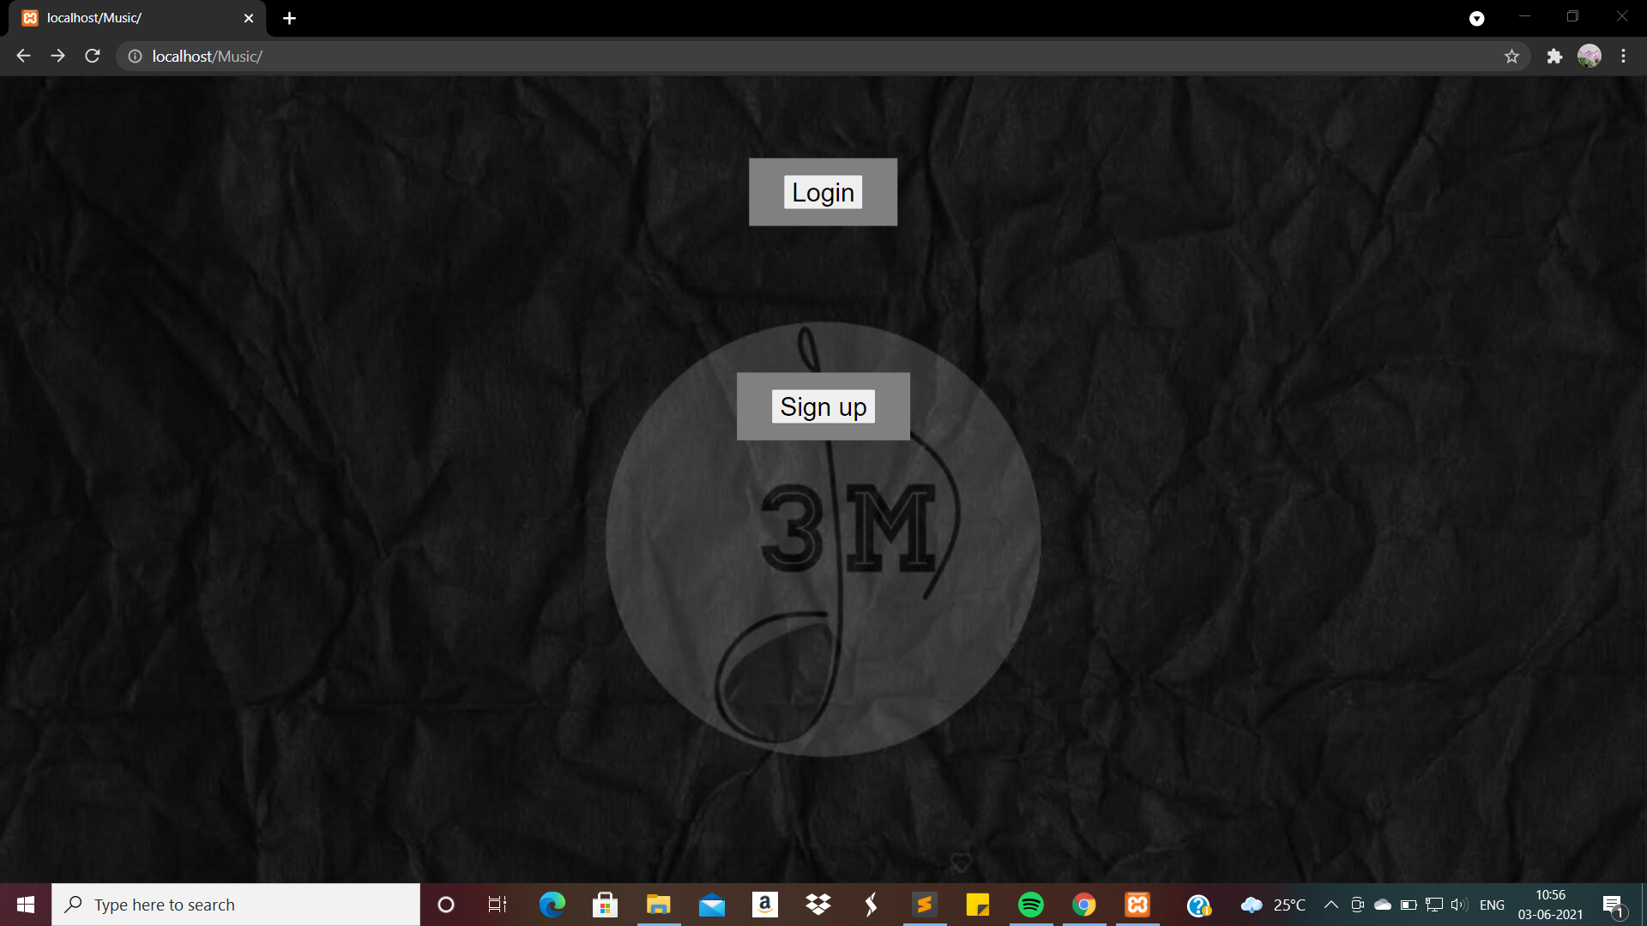
Home Page

Slide 30
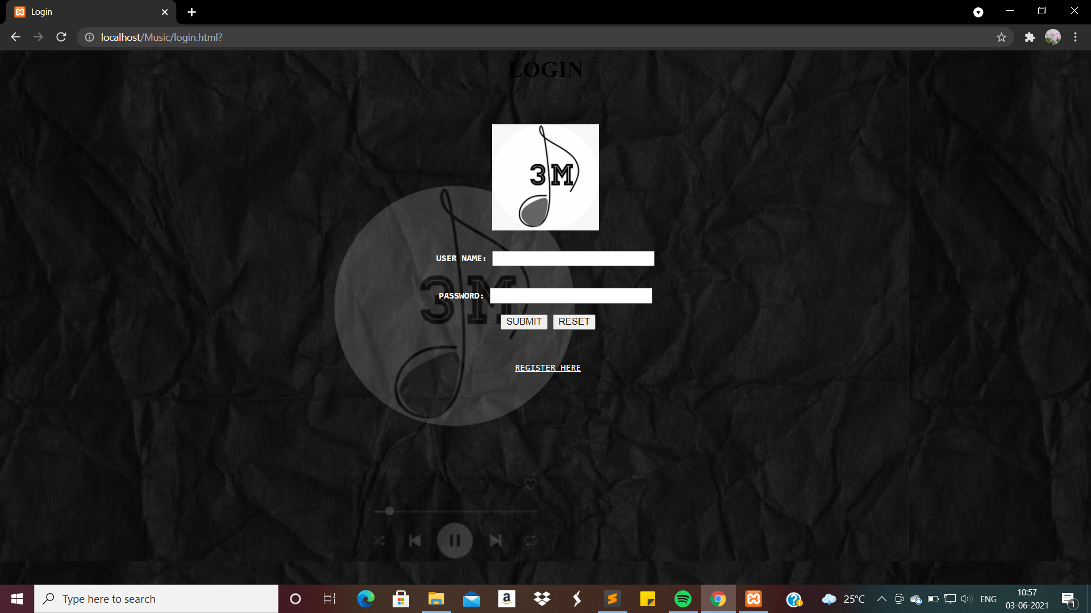
Login Page

Slide 31
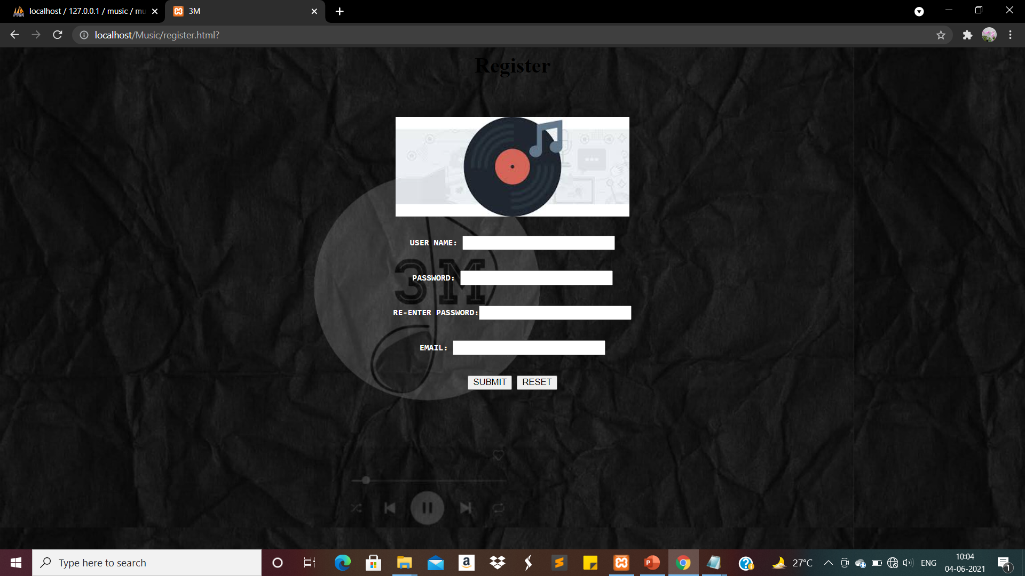
Registration Page

Slide 32

User Choice page

Slide 33
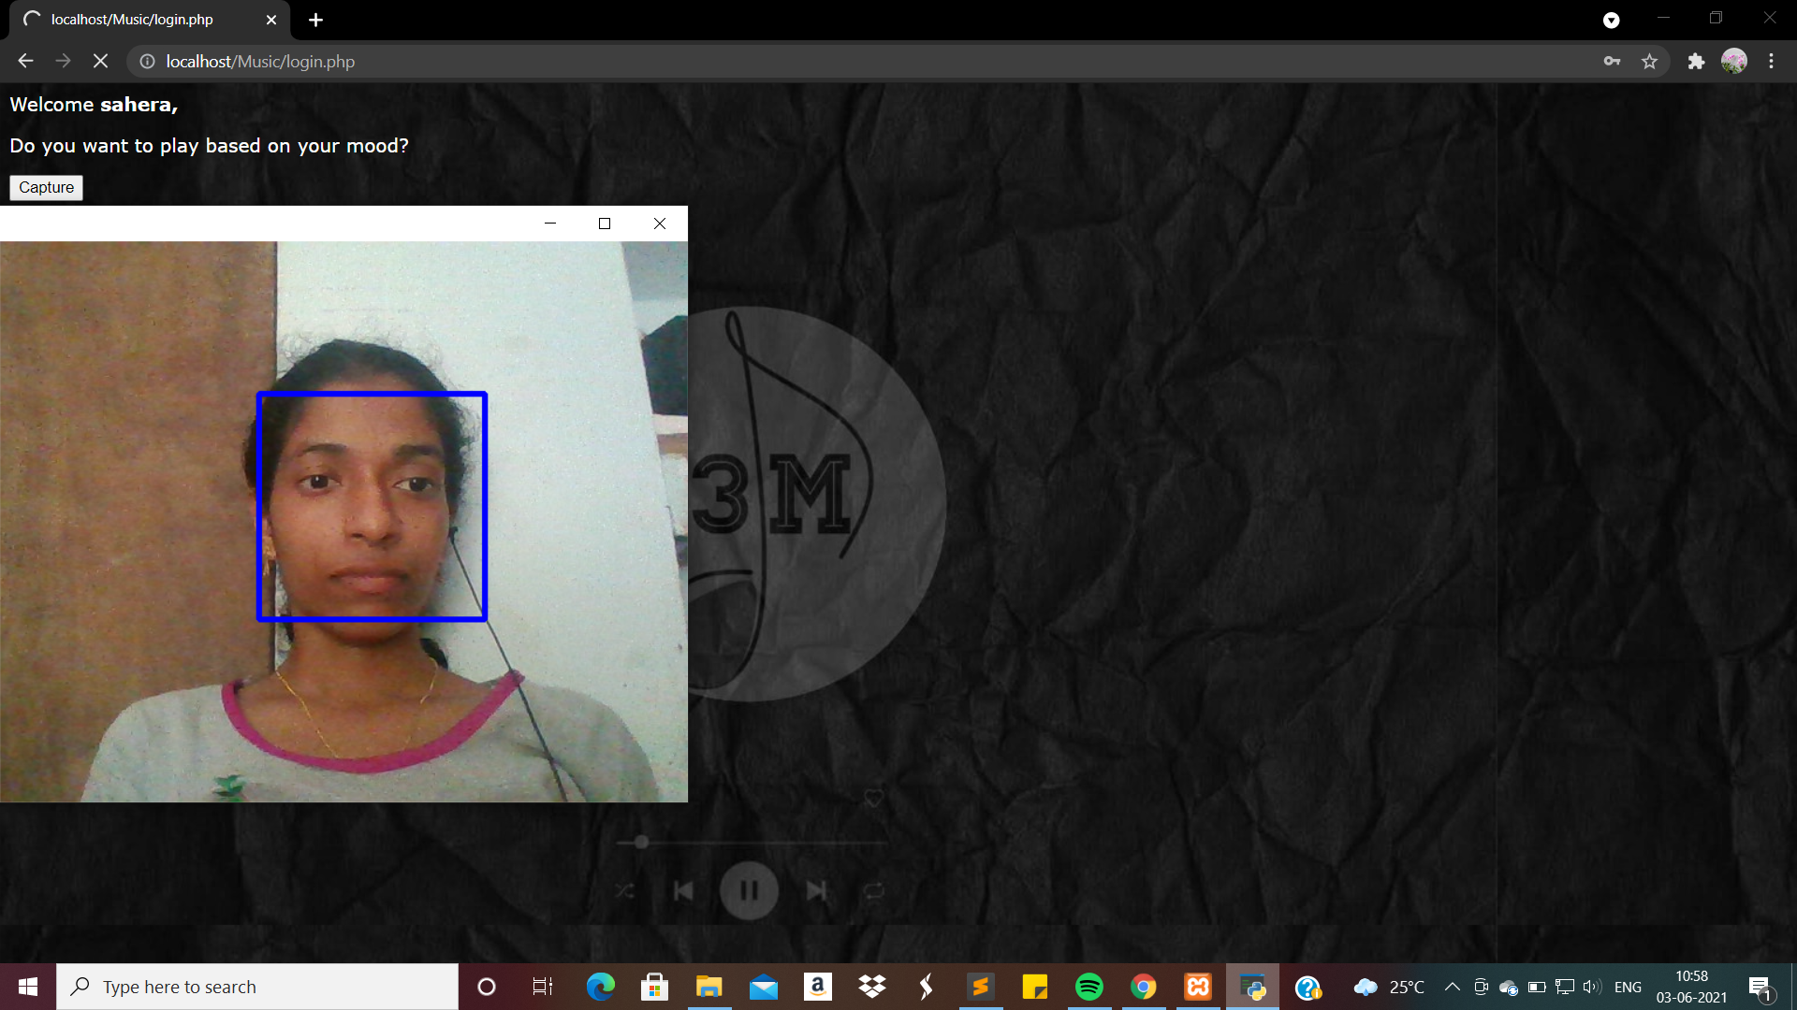
Face Detection Page

Slide 34

Confirmation Page

Slide 35
References
Emotion Detection:
https://towardsdatascience.com/emotion-detection-a-machine-learning-project-f7431f652b1f
https://sci-hub.se/https://doi.org/10.1007/978-3-662-45402-2_151
Emotion based Music Recommendation System: https://fruct.org/publications/acm26/files/Rum.pdf
https://www.jetir.org/papers/JETIR2004499.pdf

Slide 36
References
Base Papers:
https://sci-hub.se/10.1109/RTEICT.2017.8256863
https://scihub.se/https://doi.org/10.1109/CarpathianCC.2018.8399650
https://scihub.se/https://doi.org/10.1109/DeSE.2019.00188
http://noiselab.ucsd.edu/ECE285/FinalProjects/Group7.pdf

Slide 37

Any Queries..?

Slide 38
Thank you..!

